Slide 1
DNS Introduction
Author: Tam Do (dvtam@tma.com.vn)
Nov 12 ‘12

Slide 2

Agenda
Introduction
DNS structure & Components
DNS operation
Protocols details
DNS resource records
Dynamic zone update
DNS in context
Install and configure DNS server

Slide 3

1
Introduction

Slide 4
Introduction - History
  Using a host name is preferred when communicating over a network. Easily remembered than an IP address
  Before 1982, HOSTS.TXT is used to map names to numerical addresses and each computer retrieved this file a computer at SRI
  The rapid growth of the network made a centrally maintained, hand-crafted HOSTS.TXT unsustainable
  A more scalable system is needed so Domain Name System (DNS) was invented in 1983

Slide 5
Introduction - DNS
  DNS is a hierarchical distributed naming system for computers, services, or any resource connected to the Internet or a private network
  Resolves queries for domain names into IP addresses for the purpose of locating computer services and devices worldwide
  An essential component of the functionality of the Internet
  Can be quickly updated and these updates distributed
  Distributes the responsibility of assigning domain names and mapping those names to IP addresses by designating authoritative name servers for each domain

Slide 6
2
DNS structure & Components

Slide 7
DNS structure & Components
  Domain name space
  Domain name syntax
  Name servers
  Authoritative name servers

Slide 8
Domain name space
Is the structure of the DNS database
Consists a tree of domain names (also called labels)
Sub-divide into zones beginning at the root zone
A DNS zone may consist of one domain or many domains and sub-domains
Notes:
The name space is the structure of the DNS database. It is an inverted tree with the root node at the top. Each node has a label and the root node has a null label, written as “”.
Each node in the tree must have a label(A string of up to 63 8 bit bytes).Sibling nodes must have unique labels and the null label is reserved for the root node. The null label
is reserved for the root node.Conceptually, the Internet is divided into several hundred top-level domains, where each domain covers many hosts. Each domain is partitioned into subdomains ,these are further partitioned,and so on. All these domains can be represented by a tree ,as shown following:-
One domain is a subdomain of another if its apex node is a descendant of the other’s apex node. More simply, one domain is a subdomain of another if its domain name ends in the other’s domain name. For cs.yale.edu is a subdomain of yale.edu.

Slide 9
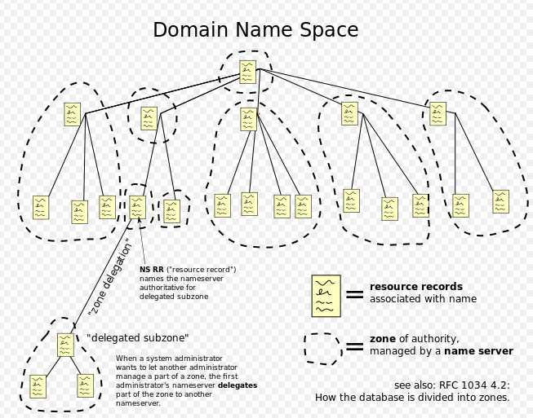
Domain name space

Slide 10
Domain name syntax
A domain name consists of one or more parts, technically called labels, that are delimited by dots, such as example.com.
The right-most label conveys the top-level domain (TLD) e.g. www.businessweek.com belongs to the TLD com
The hierarchy of domains descends from right to left; each label to the left specifies a subdivision, or sub-domain of the domain to the right. E.g. the label businessweek specifies a subdomain of the com domain.
This tree of subdivisions may have up to 127 levels.

Slide 11
Name servers
The Domain Name System is maintained by a distributed database system, which uses the client-server model.
The nodes of this database are the name servers.
Each domain has at least one authoritative DNS server that publishes information about that domain and the name servers of any domains subordinate to it.
The top of the hierarchy is served by the root nameservers, the servers to query when looking up (resolving) a TLD.

Slide 12
Authoritative name servers
Is a name server that gives answers that have been configured by an original source, e.g. the domain administrator or by dynamic DNS methods.
Can either be a master server (original copy of zones) or a slave server (identical copy of the master records)
Each DNS zone is assigned a set of authoritative name servers holding the authoritative information about that zone.
Notes:
Normally, a zone will have one primary name server, which gets its information from a file on its disk, and one or more secondary name servers, which get their information from the primary name server
A master server is a server that stores the original (master) copies of all zone records. A slave server uses an automatic updating mechanism of the DNS protocol in communication with its master to maintain an identical copy of the master records.

Slide 13
3
DNS Operation

Slide 14
DNS operation
  Address resolution mechanism
  Recursive and caching name server
  Record caching
  DNS resolver
  Reverse lookup
  Client lookup

Slide 15
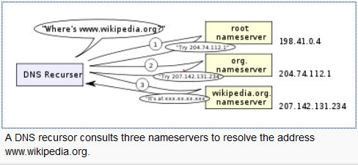
Address resolution mechanism

Slide 16
Address resolution mechanism
  1) A network host is configured with an initial cache of the known addresses of the root name servers.
  2) A query to one of the root servers to find the server authoritative for the top-level domain.
  3) A query to the obtained TLD server for the address of a DNS server authoritative for the second-level domain.
  4) Repetition of the previous step to process each domain name label in sequence, until the final step which returns the IP address of the host sought
  → This mechanism puts a large operating burden on the root servers which every search for address starts by querying one of them
Notes:
1) Such a hint file is updated periodically by an administrator from a reliable source

Slide 17
Recursive and caching name server
  With only authoritative name servers operating:
    Every DNS query must start with recursive queries at the root zone of the DNS
    Each user system must implement resolver software capable of recursive operation
  To improve efficiency, reduce DNS traffic across the Internet, and increase performance in end-user applications:
    DNS cache server (also called DNS cache) is introduced
    Store DNS query results for a period of time determined in the configuration (time-to-live) of the domain name record

Slide 18
Record caching
  Reduces the load on individual servers by caching DNS request records for a period of time after a response
  Determined by TTL associated with every record
  After the TTL period, caches expire and refresh
Notes:
This entails the local recording and subsequent consultation of the copy instead of initiating a new request upstream
The time for which a resolver caches a DNS response is determined by a value called the time to live (TTL) associated with every record
he TTL is set by the administrator of the DNS server handing out the authoritative response. The period of validity may vary from just seconds to days or even weeks

Slide 19
DNS resolver
  The client-side of the DNS is called a DNS resolver
  Responsible for a full resolution
  A DNS query may be either a non-recursive query or a recursive query:
    A non-recursive query is one in which the DNS server provides a record for a domain for which it is authoritative itself, or it provides a partial result without querying other servers.
    A recursive query is one for which the DNS server will fully answer the query (or give an error) by querying other name servers as needed. DNS servers are not required to support recursive queries
Notes:
It is responsible for initiating and sequencing the queries that ultimately lead to a full resolution (translation) of the resource sought, e.g., translation of a domain name into an IP address.

Slide 20
Reverse lookup
  Is a query of the DNS for domain names when the IP address is known
  The DNS stores IP addresses in the form of domain names as specially formatted names in pointer (PTR) records within the infrastructure top-level domain arpa
  For IPv4, the domain is in-addr.arpa. For IPv6, the revers<number>e lookup domain is ip6.arpa
  The IP address is represented as a name in reverse-ordered octet representation
  E.g. the IPv4 address 208.80.152.2 is assigned to Wikimedia then represented in reverse order like 2.152.80.208.in-addr.arpa
Notes:
When the DNS resolver gets a PTR (reverse-lookup) request, it begins by querying the root servers (which point to The American Registry For Internet Numbers' (ARIN's) servers for the 208.in-addr.arpa zone). On ARIN's servers, 152.80.208.in-addr.arpa is assigned to Wikimedia, so the resolver sends another query to the Wikimedia nameserver for 2.152.80.208.in-addr.arpa, which results in an authoritative response.

Slide 21
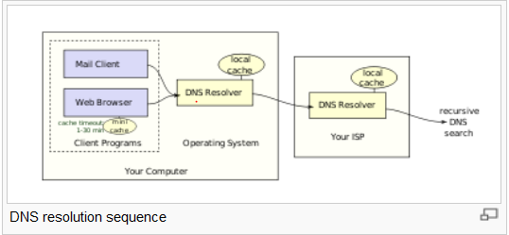
Client lookup

Slide 22
Client lookup
  Users generally do not communicate directly with a DNS resolver
  DNS resolution takes place transparently in applications such as web browsers, e-mail clients, and other Internet applications
  Such programs send a resolution request to the DNS resolver in the local operating system
Notes:
If the cache can provide the answer to the request, the resolver will return the value in the cache to the program that made the request. If the cache does not contain the answer, the resolver will send the request to one or more designated DNS servers. In the case of most home users, the Internet service provider to which the machine connects will usually supply this DNS server: such a user will either have configured that server's address manually or allowed DHCP to set it; however, where systems administrators have configured systems to use their own DNS servers, their DNS resolvers point to separately maintained nameservers of the organization. In any event, the name server thus queried will follow the process outlined above, until it either successfully finds a result or does not. It then returns its results to the DNS resolver; assuming it has found a result, the resolver duly caches that result for future use, and hands the result back to the software which initiated the request

Slide 23
4
Protocol details

Slide 24
Protocol details
  Primarily uses User Datagram Protocol (UDP) on port number 53 to serve requests
  DNS queries consist of a single UDP request from the client followed by a single UDP reply from the server
  The TCP is used when the response data size exceeds 512 bytes, or for tasks such as zone transfers

Slide 25
5
DNS resource records

Slide 26
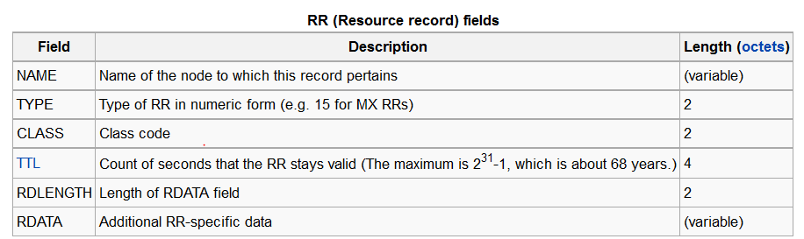
DNS resource records
  Is the basic data element in the domain name system
  Each record has a type (A, MX, etc.), an expiration time limit, a class, and some type-specific data.

Slide 27
DNS resource records
  NAME is the fully qualified domain name of the node in the tree
  TYPE is the record type. It indicates the format of the data and it gives a hint of its intended use.
    Full list of DNS record types: http://en.wikipedia.org/wiki/List_of_DNS_record_types
  E.g. the A record is used to translate from a domain name to an IPv4 address
  RDATA is data of type-specific relevance, such as the IP address for address records
  The CLASS of a record is set to IN (for Internet) for common DNS records involving Internet hostnames, servers, or IP addresses
Notes:
NAME is the fully qualified domain name of the node in the tree
TYPE is the record type. It indicates the format of the data and it gives a hint of its intended use. For example, the A record is used to translate from a domain name to an IPv4 address, the NS record lists which name servers can answer lookups on a DNS zone, and the MX record specifies the mail server used to handle mail for a domain specified in an e-mail address (see also List of DNS record types).
RDATA is data of type-specific relevance, such as the IP address for address records, or the priority and hostname for MX records.
The CLASS of a record is set to IN (for Internet) for common DNS records involving Internet hostnames, servers, or IP addresses.
In addition to resource records defined in a zone file, the domain name system also defines several request types that are used only in communication with other DNS nodes (on the wire), such as when performing zone transfers (AXFR/IXFR) or for EDNS (OPT)

Slide 28
6
Dynamic zone update

Slide 29
Dynamic zone update
  Dynamic DNS updates use the UPDATE DNS opcode to add or remove resource records dynamically from a zone data base maintained on an authoritative DNS server
  Useful to register network clients into the DNS when their IP addresses change on the go.
Notes:
Dynamic DNS updates use the UPDATE DNS opcode to add or remove resource records dynamically from a zone data base maintained on an authoritative DNS server. The feature is described in RFC 2136. This facility is useful to register network clients into the DNS when they boot or become otherwise available on the network. Since a booting client may be assigned a different IP address each time from a DHCP server, it is not possible to provide static DNS assignments for such clients.

Slide 30
7
DNS in context

Slide 31
DNS in context
  Performance concerns:
  DNS is a very lightweight protocol: - Simple query – response.
  Any performance limitations are the result of network limitations:
    -Speed of light
    -Network congestion
    -Switching/forwarding latencies
  Security concerns:
    Base DNS protocol (RFC 1034, 1035) is insecure
    DNS Security Enhancements (DNSSEC, RFC 2565) remedies this flaw

Slide 32
8
Install and configure DNS server

Slide 33
Install and configure DNS server
  Reference sites (step by step):
    Windows 2003:
      http://support.microsoft.com/kb/814591
    Linux using BIND:
      http://linuxconfig.org/linux-dns-server-bind-configuration
      http://www.linuxhomenetworking.com/wiki/index.php/Quick_HOWTO_:_Ch18_:_Configuring_DNS#.UKQkRYb6jIU

Slide 34
Q & A

